Slide 1

SANJIVANI UNIVERSITY
School of Engineering & Technology
………………………………………………………………………………………….
Department of Artificial Intelligence & Data Science
IOT Project Topic
IOT BASED SMART COOKING SYSTEM
Presented By :
Aher Darshan (2124UDSM2027)
Under the Guidance of
Dr. Kiran Wakchaure

Slide 2
Content
Introduction
Problem Statement
Problem Solution
How it Works (Flow)
Components
Circuit Diagram
System Features
Mobile Notification (Telegram Bot)
Conclusion

Slide 3
Introduction
The kitchen is a vital part of every home, but traditional cooking methods can lead to safety risks like gas leaks, overcooking, and unattended flames. This project introduces a Smart Cooking System using ESP32 and IoT technology to automate cooking tasks. It detects pressure cooker whistles, milk boiling, and gas leaks, and responds by turning off the gas and sending alerts via Telegram bot. The system ensures safer, more convenient, and efficient cooking for modern households.

Slide 4
Problem Statement
In traditional kitchens, cooking requires continuous monitoring, especially when using gas stoves. Accidents can occur due to:
Forgetting to turn off the gas after cooking.
Gas leaks going undetected.
Overboiling of milk or delayed whistle detection in pressure cookers.
These issues pose safety risks, gas wastage, and inconvenience, especially for busy individuals or the elderly. There is a lack of smart automation and real-time alert systems in conventional cooking setups.

Slide 5
Problem Solution
This project proposes an IoT-Based Smart Cooking System that automates critical cooking tasks and enhances kitchen safety. Using an ESP32 microcontroller, it integrates a microphone sensor to detect pressure cooker whistles, a gas sensor (MQ-2) to detect leaks, and a servo motor to automatically turn off the gas.
Key features of the solution:
Automatically turns off gas after 3 whistles during pressure cooking.
Detects milk boiling and shuts off the flame after a set time.
Continuously monitors for LPG gas leaks and raises an alert via buzzer and Telegram bot.
Sends real-time notifications to the user through a Telegram bot, allowing remote monitoring.
This system provides an affordable, safe, and efficient cooking automation solution for modern households.

Slide 6
How it works (Flow)
System Turns ON and waits for cooking to begin.
Microphone Sensor Detects pressure cooker whistles, count up to 3, send signal to servo motor to turn off gas, alert via Telegram bot.
If milk boiling is detected via timer, after 3 minutes, system turns off gas automatically.
MQ-2 gas sensor continuously check for LPG leakage. On detection it :
Activates buzzer
Turns off gas via servo
Send alert through Telegram

Slide 7
Components
ESP32 : Main Controller with wi-fi for cloud communication
Microphone sensor : Detects pressure cooker whistles.
MQ-2 Gasa Sensor : Detects LPG gas leakage.
Servo Motor : Physically turns the gas knob off.
Switch : Manual ON/OFF control for user input.
Buzzer : Alert during gas leak or cooking completion
Power Booster + Battery : Power the ESP32 and components during operation
Telegram Bot : Sends real time cooking status alert to the user.

Slide 8
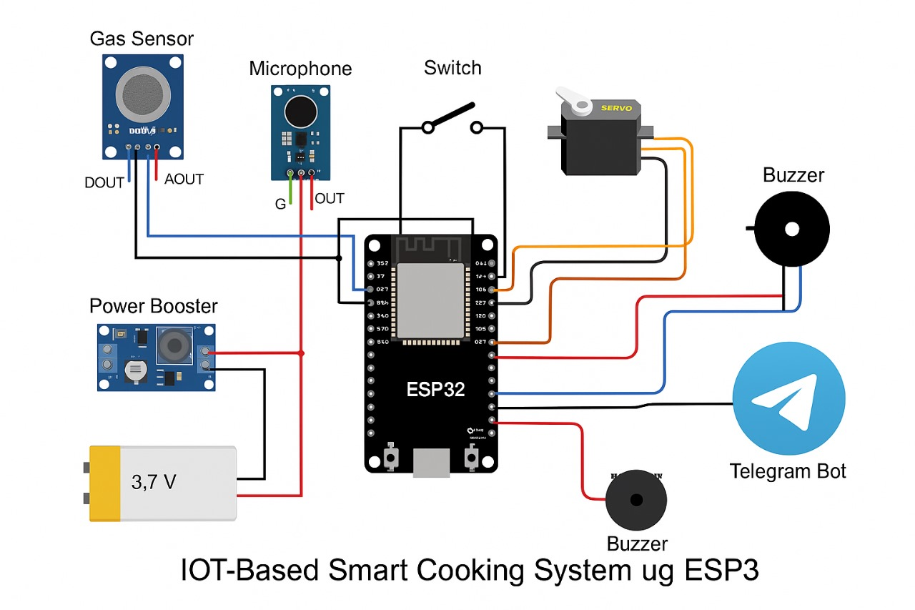
Circuit Diagram

Slide 9
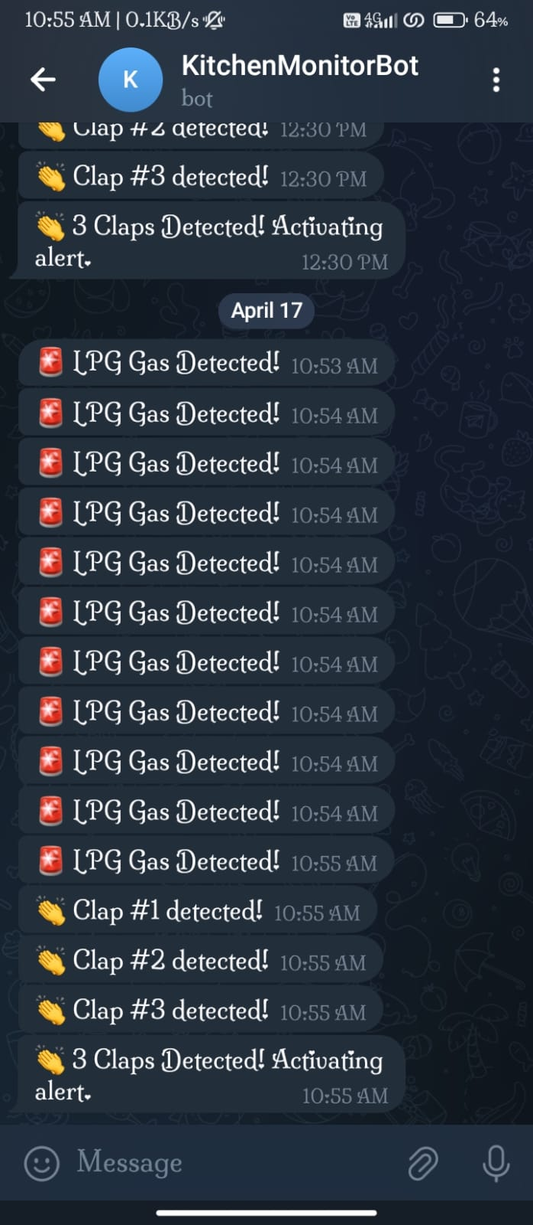
Android Notification (Telegram Bot)

Slide 10
System Features
Automatic Gas OFF after 3 whistles.
Gas OFF 3 minutes after milk start boiling.
Gas Leak Detection with buzzer and mobile alert
Telegram Alert System for real time update.
Manual override with switch

Slide 11
Conclusion
The Smart Cooking System successfully demonstrates how IoT technology can make traditional cooking safer and more efficient. By detecting pressure cooker whistles, milk boiling, and gas leaks, the system automates critical tasks and sends real-time alerts via a Telegram bot. This not only reduces the risk of accidents but also adds convenience to daily life. The project offers a practical and affordable solution for modern smart kitchens.

Slide 12
THANK YOU

